Slide 1
Electronic Devices and Circuits Lecture-7
CSE 223

Slide 2
Field Effect Transistors
(FET)
Chapter – 5 (Boylestad)

Slide 3
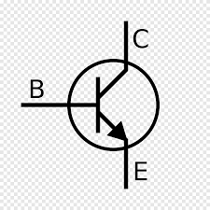
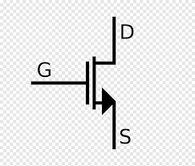
Article 5.1
BJT vs FET
Similarities
1. BJT is a three-terminal device
Field-effect transistor (FET) is a three-terminal
2. Applications of FETs are same as the applications of BJTs
BJT
FET
D=Drain
G=Gate
S=Source
Dissimilarities
3. BJT transistor is a current-controlled device
FET is a voltage-controlled device
4. BJT transistor is a bipolar device, conduction level is a function of two charge carriers, electrons and holes
FET is a unipolar device, conduction depends on either electron (n-channel) or hole (p- channel)

Slide 4
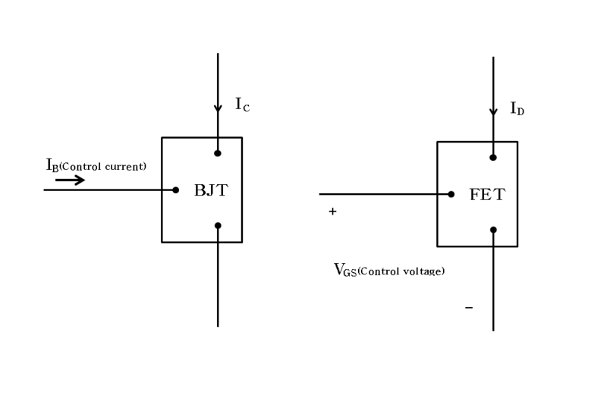
5. BJT : n-p-n p-n-p
FET: n- channel p-channel
FETs are more temperature stable than
BJTs
FETs are usually smaller in construction than BJTs, making them particularly useful in integrated-circuit (IC) chips
As the input circuit (gate to source) of a JFET is reverse biased, the device has high input impedance. However, the input circuit of a BJT is forward biased and hence has low input impedance
Output current
Output current
Ic=Function(IB)
ID=Function(VGS)
Why it is called Field Effect transistor?
For the FET an electric field is established by the charges present. This electric field will control the current conduction path of the output circuit without the need for direct contact with the current conduction path

Slide 5
Field Effect Transistor
In BJT, both holes and electrons play part in the conduction process. BJT has two principal disadvantages:
It has a low input impedance because of forward biased emitter junction
It has a considerable noise level
Main Difference:
A bipolar junction transistor is a current controlled device, that is, output characteristics of the device are controlled by base current and not by base voltage.
However, in a field effect transistor (FET), the output characteristics are controlled by input voltage and not by input current. This is probably the biggest difference between BJT and FET.
Prepared by Ipshita Tasnim Raha

Slide 6
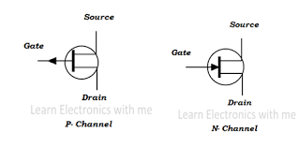
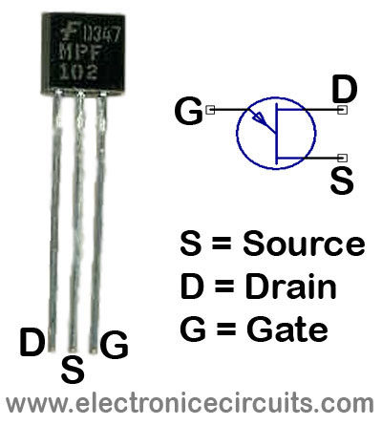
Field Effect Transistor
There are two basic types of field effect transistors:
1. Junction field effect transistor (JFET)
2. Metal oxide semiconductor field effect transistor (MOSFET)
A junction field effect transistor (JFET) is a three terminal semiconductor device in which current conduction is by one type of carrier that is, electrons or holes.
Symbol of a n-channel JFET
Prepared by Ipshita Tasnim Raha

Slide 7

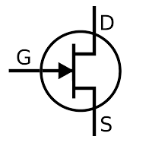
Drain= from where output current is taken
Source= source of water, from where current is coming from
Gate= valve of a tap, controls current flow
Gate
Source
Drain
Id
+
Vgs
-
Is
Fig.: Water analogy for a JFET

Slide 8
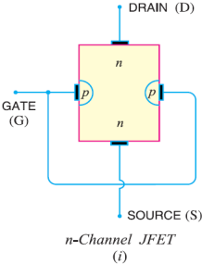
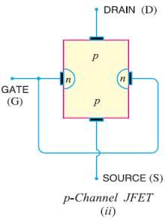
Constructional details of JFET (Article 5.2)
The basic construction of the n-channel JFET:
The major part of the structure is the n-type material that forms the channel between the embedded layers of p-type material. The top of the n-type channel is connected through an ohmic contact to a terminal referred to as the drain (D), while the lower end of the same material is connected through an ohmic contact to a terminal referred to as the source (S). The two p-type materials are connected together and to the gate (G) terminal
N-channel JFET construction
Prepared by Ipshita Tasnim Raha

Slide 9
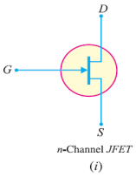
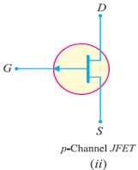
Symbol of JFET:
The symbol of JFET is given below,
The vertical line in the symbol may be thought as channel and source (S) and drain (D) connected to this line. If the channel is n-type, the arrow on the gate points towards the channel and for p-type channel, the arrow on the gate points from channel to gate
Prepared by Ipshita Tasnim Raha

Slide 10
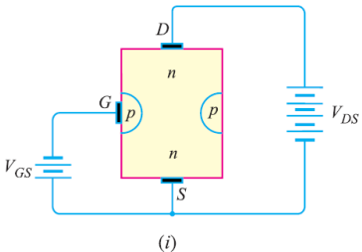
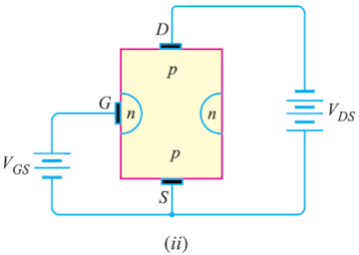
JFET polarities
Figure (i) shows n-channel JFET polarities whereas Figure (ii) shows the p-channel JFET polarities. Note that in each case, the voltage between the gate and source is such that the gate is reverse biased. This is the normal way of JFET connection. The drain and source terminals are interchangeable that is, either end can be used as source and the other end as drain.
Prepared by Ipshita Tasnim Raha

Slide 11
JFET polarities
The following points may be noted:
(i) The input circuit (gate to source) of a JFET is reverse biased. This means that the device has high input impedance.
(ii) The drain is so biased with respect to source that drain current ID flows from the source to drain.
(iii) In all JFETs, IG=0 A (approx.) and source current IS is equal to the drain current. That is, I_{S} = I_{D}
ID
Prepared by Ipshita Tasnim Raha

Slide 12
Basic Principle of JFET
The two p-n junctions at the sides form two depletion layers. The current conduction by charge carriers (free electrons in this case) is through the channel between the two depletion layers and out of the drain. The width and hence resistance of this channel can be controlled by changing the input voltage V_{GS}. The greater the reverse voltage V_{GS}, the wider will be the depletion layers and narrower will be the conducting channel.
The narrower channel means greater resistance and hence source to drain current decreases. Reverse will happen should V_{GS} decrease.
Thus JFET operates on the principle that width and hence resistance of the conducting channel can be varied by changing the reverse voltage V_{GS}. In other words, the magnitude of drain current (I_{D}) can be changed by altering V_{GS}.
Prepared by Ipshita Tasnim Raha

Slide 13
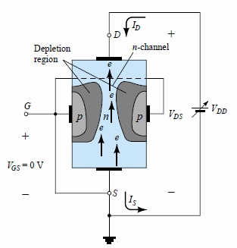
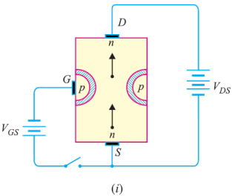
Working of JFET
1. When VGS = 0 V (VG=VS) and a voltage VDS=VDD is applied between drain and source terminals [Figure (i)], the two p-n junctions at the sides of the bar establish depletion layers. The electrons will flow from source to drain through a channel between the depletion layers. The size of these depletion layers determines the width of the channel and hence the current conduction through the bar.
+
=VDD
-
Prepared by Ipshita Tasnim Raha

Slide 14
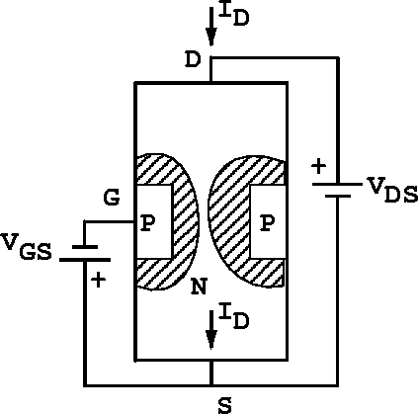
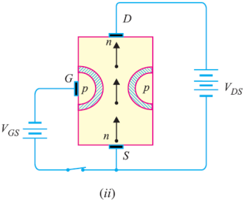
Working of JFET
2. When a reverse voltage VGS (VGS< 0 V) is applied between the gate and source [Figure (ii)], the width of the depletion layers is increased. This reduces the width of conducting channel, there by increasing the resistance of n-type bar. Consequently, the current from source to drain is decreased. On the other hand, if the reverse voltage on the gate is decreased, the width of the depletion layers also decreases. This increases the width of the conducting channel and hence source to drain current.
Prepared by Ipshita Tasnim Raha

Slide 15
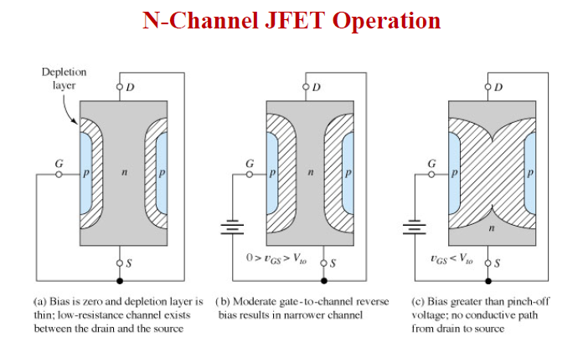

Slide 16
Working of JFET
It is clear from the above discussion that current from source to drain can be controlled by the application of potential on the gate. For this reason, the device is called field effect transistor. It may be noted that a p-channel JFET operates in the same manner as an n -channel JFET except that channel current carriers will be the holes instead of electrons and the polarities of VGS and VDS are reversed.
Pinch off voltage:
If VDS is increased to a level where it appears that the two depletion regions would “touch”, a condition referred to as pinch-off will result. The level of VDS that establishes this condition is referred to as the pinch-off voltage and is denoted by VP.
At pinch-off voltage, the drain to source current becomes almost constant and JFET enters into the saturation region. Vp is defined only when gate to source voltage (VGS=0) is zero.
Prepared by Ipshita Tasnim Raha

Slide 17
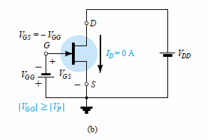
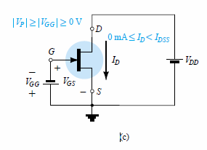
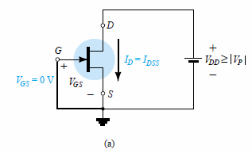
Summary
For n-channel JFETs include the following:
The maximum current is defined as IDSS and occurs when Vgs=0 V and VDS =|VP| as shown in Fig. 5.14a.
For gate-to-source voltages VGS less than (more negative than) the pinch-off level, the drain current is 0 A (ID =0 A) as appearing in Fig. 5.14b.
For all levels of VGS between 0 V and the pinch-off level, the current ID will range between IDSS and 0 A, respectively, as reviewed by Fig. 5.14c

Slide 18
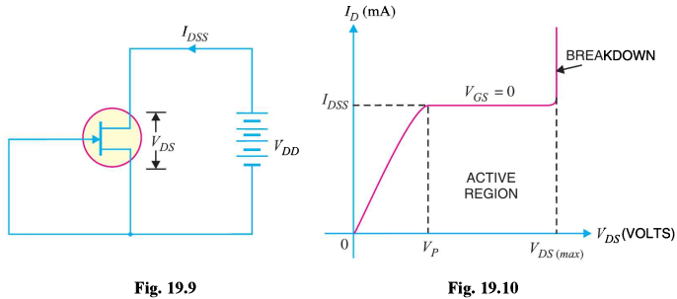
Some Important Terms
IDSS is the maximum drain current for a JFET and is defined by the conditions
VGS 0 V and VDS |VP|.
Prepared by Ipshita Tasnim Raha

Slide 19
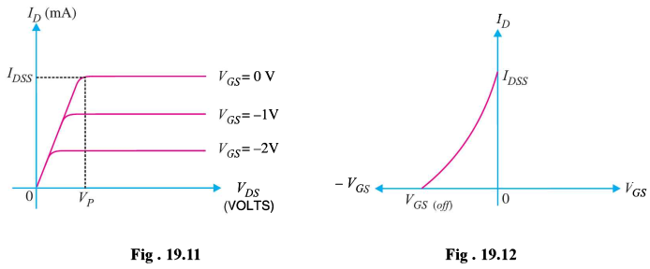
Some Important Terms
Prepared by Ipshita Tasnim Raha

Slide 20
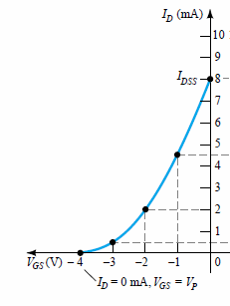
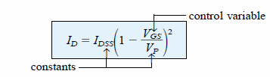
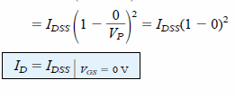
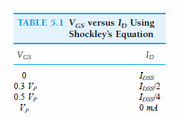
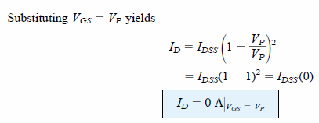
When VGS= 0 V
Example 5.1 (DIY)

Slide 21
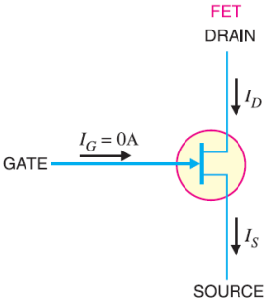
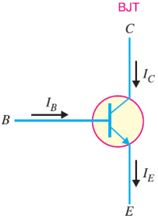
Difference Between JFET and BJT
(i) In a JFET, there is only one type of carrier, holes in p-type channel and electrons in n-type channel. For this reason, it is also called a unipolar transistor. However, in an ordinary transistor, both holes and electrons play part in conduction. Therefore, an ordinary transistor is sometimes called a bipolar transistor. (ii) As the input circuit (gate to source) of a JFET is reverse biased, therefore, the device has high input impedance. However, the input circuit of an ordinary transistor is forward biased and hence has low input impedance. (iii) The primary functional difference between the JFET and the BJT is that no current (actually, a very, very small current) enters the gate of JFET (IG = 0A). However, typical BJT base current might be a few μA while JFET gate current a thousand times smaller.
Prepared by Ipshita Tasnim Raha

Slide 22
Difference Between JFET and BJT
(iv) A bipolar transistor uses a current into its base to control a large current between collector and emitter whereas a JFET uses voltage on the ‘gate’ (= base) terminal to control the current between drain (= collector) and source ( = emitter). Thus a bipolar transistor gain is characterized by current gain whereas the JFET gain is characterized as a transconductance that is, the ratio of change in output current (drain current) to the input (gate) voltage.
(v) In JFET, there are no junctions as in an ordinary transistor. The conduction is through an n-type or p-type semiconductor material. For this reason, the noise level in JFET is very small.
Prepared by Ipshita Tasnim Raha

Slide 23
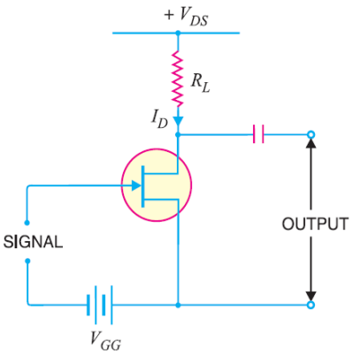
JFET as an Amplifier
In JFET amplifier circuit, a weak signal is applied between gate and source and amplified output is obtained in the drain-source circuit. For the proper operation of JFET, the gate must be negative with respect to source, that is, input circuit should always be reverse biased. This is achieved either by inserting a battery V_{GG} in the gate circuit or by a circuit known as biasing circuit.
In the present case, we are providing biasing by the battery V_{GG}. A small change in the reverse bias on the gate produces a large change in drain current. This fact makes JFET capable of raising the strength of a weak signal.
Prepared by Ipshita Tasnim Raha

Slide 24
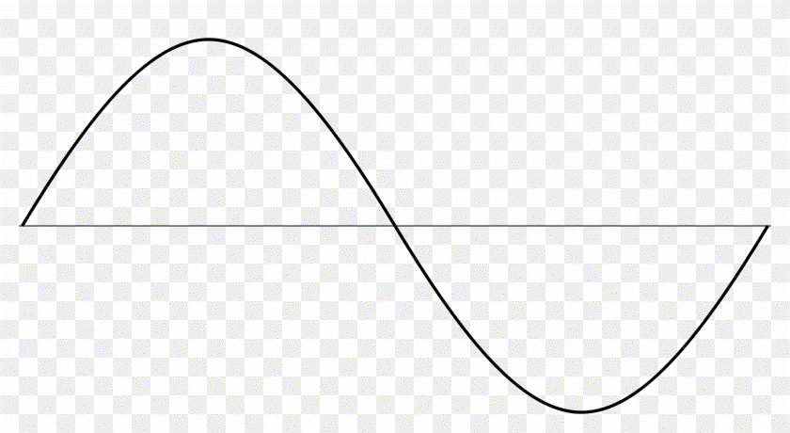
JFET as an Amplifier
During the positive half of signal, the reverse bias on the gate decreases. This increases the channel width and hence the drain current.
During the negative half-cycle of the signal, the reverse voltage on the gate increases. Consequently, the drain current decreases.
The result is that a small change in voltage at the gate produces a large change in drain current. These large variations in drain current produce large output across the load RL. In this way, JFET acts as an amplifier.
Weak signal
Prepared by Ipshita Tasnim Raha

Slide 25
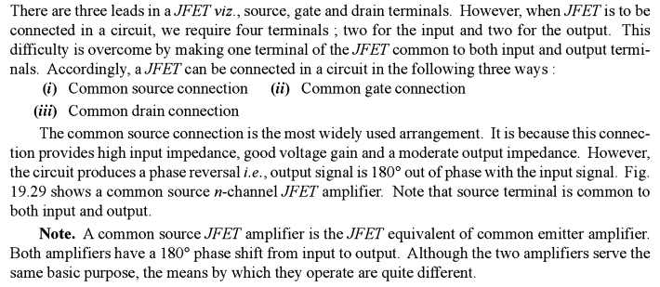
JFET Connections
Prepared by Ipshita Tasnim Raha

Slide 26
Thanks!
Any questions?

